Slide 1

QTM 151: Introduction to Statistical Computing II
Dr. Juan Estrada

Slide 2
Agenda
Introductions
CLASS DETAILS
COMPUTING Environment

Slide 3

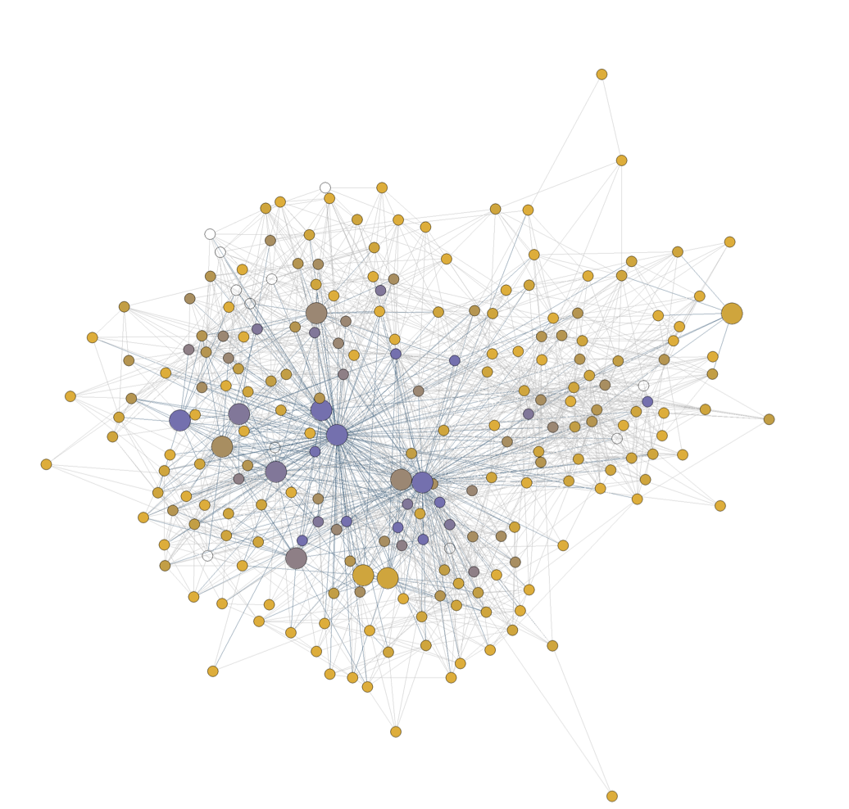
About me
My name is Juan Estrada
I finished my Ph.D. in Economics at Emory
I’m originally from Colombia
My research focuses on causal inference and network analysis. I focus on applications related with American politics
I do a lot of Python programming and data analysis in my research

Slide 4

My teaching philosophy
I like an interactive class where I engage with the students
With our class size it will be difficult—I will use a more lecture oriented approach for this class
Come to my office hours with questions so I can get to know you!
We will also constantly do “try it yourself” exercises
We will have a class Zoom meeting active every class so you can follow the screen in your own computers and ask questions! (Thank the TAs for the idea!)
QTM-151-1: Intro.to Stat.Computing II - Fall 2023 (emory.edu)

Slide 5
Teaching Assistants
Neil Das (neil.das@emory.edu). Junior
Vincent (Tianze) Luo (tluo35@emory.edu). Senior
Jeremy (Yichi) Zhang (jeremy.zhang@emory.edu). Junior
They will be answering questions during our lectures and holding office hours (see Canvas for office hours information).

Slide 6
Agenda
Introductions
CLASS DETAILS
COMPUTING Environment

Slide 7





Our class in a nutshell …
Virtual Environment
+
Python
VS Code Interactive Development Environment (IDE)
Environment where the user writes the scripts
Script File
File with code in the Python programming language.
Instructions for the program to follow
(in background)
Programming language we use to write the instructions

Slide 8
Installing Python using Anaconda
Follow the instructions Installing Python Using Anaconda from Canvas
We are using Anaconda virtual environments for this class (I will cover this in more detail next class)
For now: Anaconda comes with a Python installation
Questions?

Slide 9
Installing VS code and connecting Anaconda
Follow the instructions Installing Visual Studio Code and Connecting it with Anaconda from Canvas
For now: know that “base” is the default Anaconda virtual environment that comes by default with the installation
The next step is to check if the connection between VS code and Anaconda worked → the Python: Select Interpreter option should include Python 3.11.4 (‘base’)
Next step: we are creating a new folder for the QTM151 course and downloading our virtual GitHub folder and opening it in VS Code

Slide 10
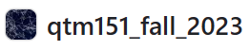


Lecture Notes
+
Python
VS Code
Github:
A file management system in the cloud (with desktop app)
Has version control
Great for collaborative programming

Slide 11
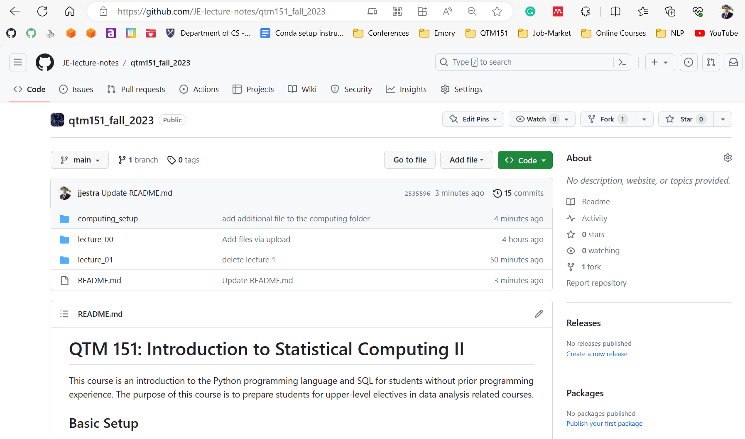
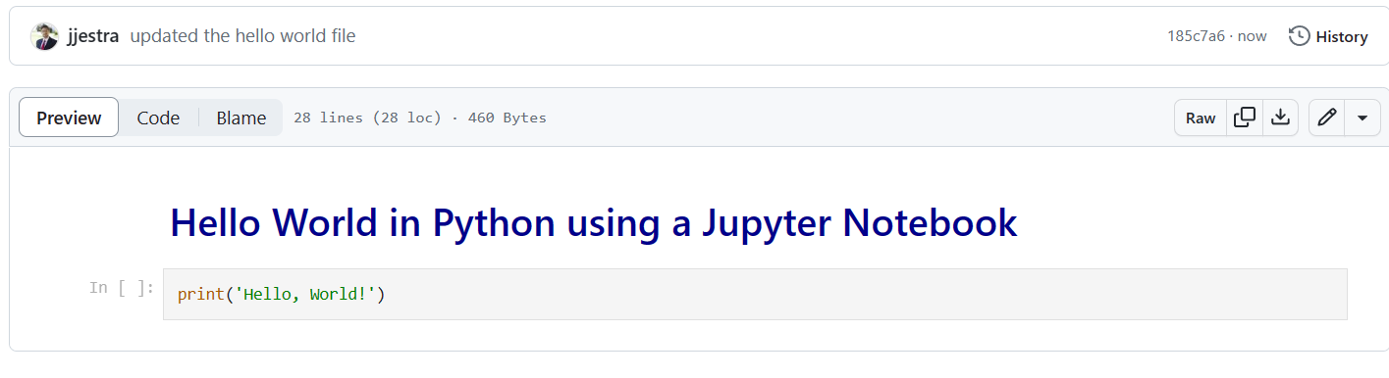
Lecture notes are publicly available at my GitHub website (link posted on Canvas):
JE-lecture-notes/qtm151_fall_2023 (github.com)
You can view the lectures in the browser

Slide 12
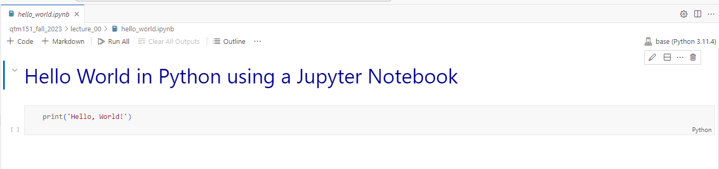

Downloading the lecture notes locally
Follow the instructions Github1 Getting Started from Canvas
Focusing on Step 2: Downloading Lectures to your Computer
Check that we have access to the folder with the lecture notes and open it in VS code → Check that VS code is connected to Anaconda

Slide 13
A Jupyter Notebook (“.ipynb”) is a file with code (python) and annotations (markdown)
All the lecture notes are written as Jupyter notebooks
It is encouraged that you bring your laptop to class
Lecture notes are designed to be follow-along. There will be “try it yourself” exercises.

Slide 14

+
Python
VS Code
See Assignment 1 (due Tuesday, August 29 at 10 p.m.):
Basics of a Jupyter notebook
Need to have all the tools installed
Install soon that we can help you with any issues!

Slide 15
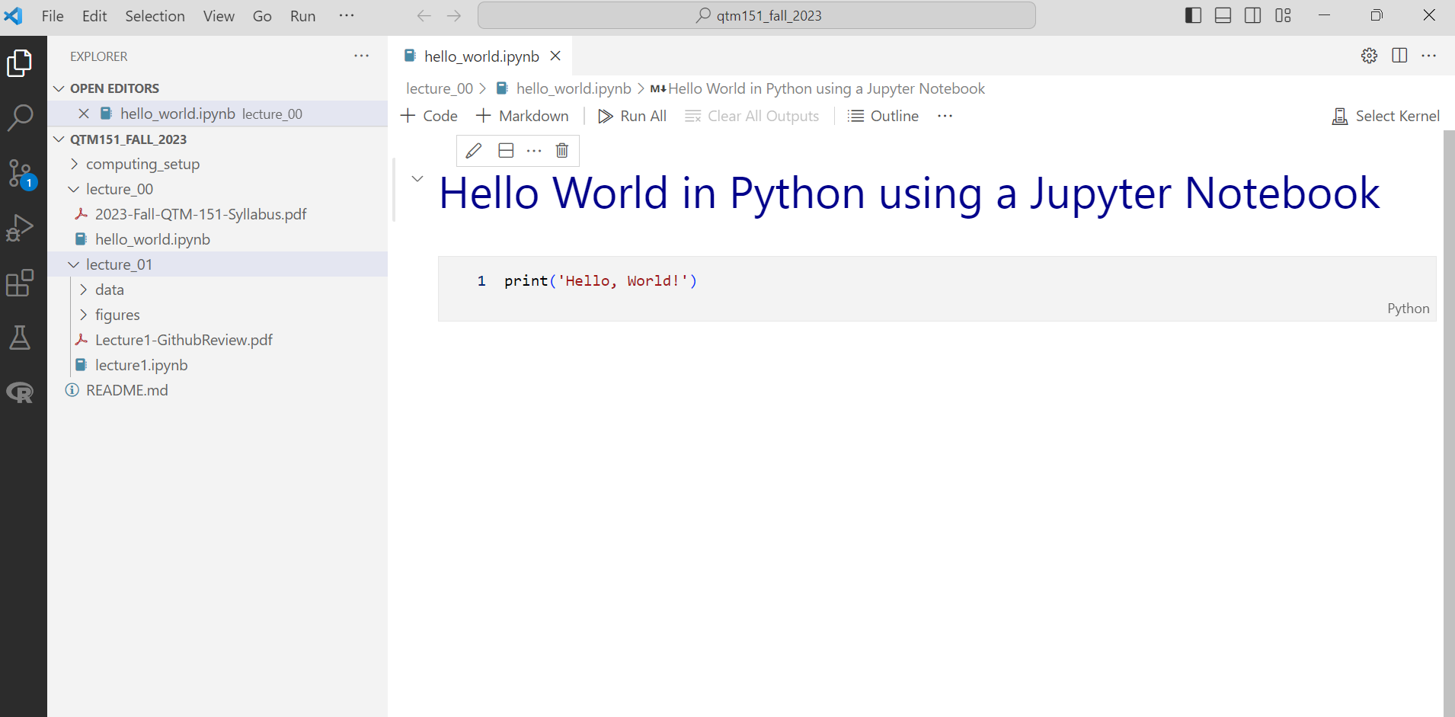
We will do all our coding in Visual Studio Code
Python
“.ipynb”: Interactive Python Notebook
Lecture notes

Slide 16
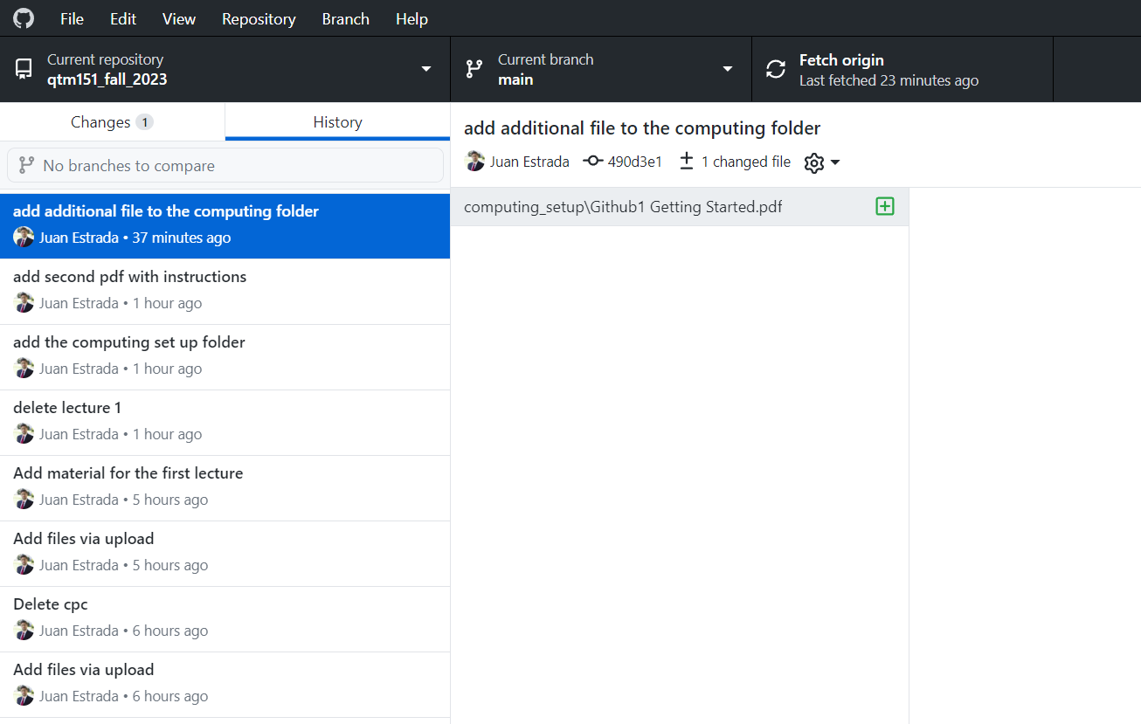
Github Desktop will allow you to automatically download the lectures notes from my account (and update them).
It will also show you
the date of any update
what the changes are
Update the lecture notes before class!

Slide 17
Questions about computing environment?

Slide 18
Agenda
Introductions
CLASS DETAILS
COMPUTING Environment

Slide 19
Learning Objectives
Learn how to code effectively in Python and SQL
I will include some Large Language Models (Chat GPT) for coding
Learn about key programming principles
Learn how to manipulate and visualize data

Slide 20
Grades
Late submissions
Late assignments will not receive points
To account for unforeseen circumstances, we will drop the worst assignment and the worst quiz
Watch out for the assignments to install software (1, 10). You will need these to be able to use the lectures notes.
Assignments (x 10): 50%
Practice class concepts
Quizzes (x5): 30%
Questions are given in advance
Data is provided in the class
Final Project: 20 %
Will provide guidelines on Canvas
Due at the end of the semester (December 8, 2023)
Midsemester Survey: + 0.5% (Extra)

Slide 21
Coding ability is not innate
Coding ability can be developed.
Academic skills and abilities are acquired through hard work, mistakes, and perseverance.
My only goal here is that you learn the material. Please ask me questions!

Slide 22
Questions about the logistics

